Slide 1
Reading People’s Minds From Emotion Expressions in Interdependent Decision Making
Celso M. de Melo, Peter J. Carnevale, Stephen J. Read, and Jonathan Gratch University of Southern California
2013

Slide 2
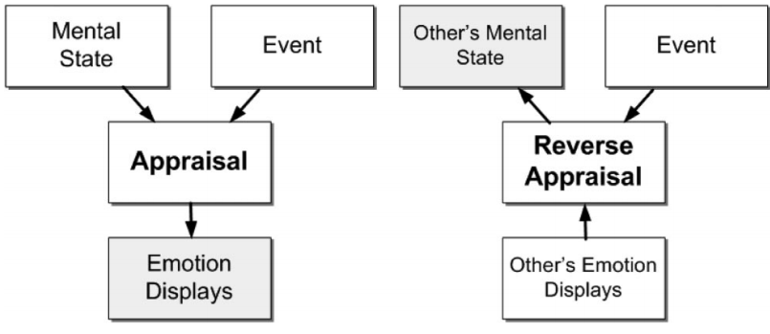
Appraisal theory
Specific event does not define by itself which emotion an individual should experience. It is the appraisal of the situation with respect to the individual’s goals that defines which emotion will be experienced

Slide 3
Общая гипотеза
People retrieve, from emotion expressions, information about others’ appraisals, which then lead to inferences about others’ mental states
*interdependent decision making: взаимозависимое (совместное) принятие решений

Slide 4
Сопутствующие феномены
Emotional contagion and (mis)attributing the current affective state to the current context (i.e., the affect-as-information heuristic)

Slide 5
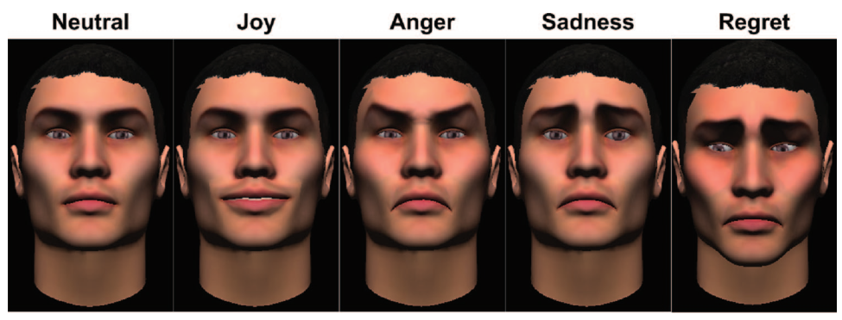
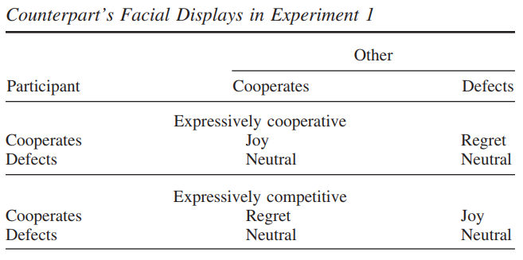
Гипотезы экспериментов
1 эксперимент
Critical social effect of emotion is the underlying information rather than the displays themselves: same emotion display produced opposite effects depending on context.
People cooperate more with an expressively cooperative counterpart than with an expressively competitive counterpart

Slide 6
Гипотезы экспериментов
2 эксперимент
Information about others’ appraisals is a critical component of the information people retrieve from emotion expressions.

Slide 7
Гипотезы экспериментов
3, 4 и 5 эксперименты
Emotion expressions cause perceptions of appraisals, which then cause inferences about expectations of cooperation.
Facial displays of joy, sadness, anger and regret impacted people’s expectations of cooperation. Explicitly communicating appraisals can impact expectations of cooperation in the same way the corresponding facial expressions

